Slide 1

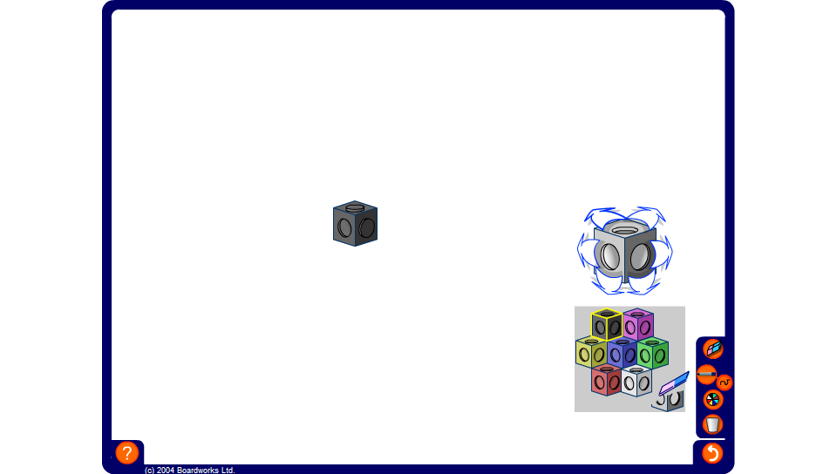


Describing 3-D shapes made from cubes
Notes:
For this activity you will need a set of interconnecting cubes. Ask a volunteer to stand with their back to the board while you construct a 3-D shape using the virtual cubes on the board.
Members of the class must describe the shape shown on the board to the volunteer who must create the shape using real multilink cubes.

